Slide 3

Probabilistic Library
Edwin Spee Karolina Wojciechowska
Rob Brinkman Arjen Markus
Naam Achternaam

Slide 4
Situatie januari 2024
Data
Visualisatie
Hydra-Ring
Waterstand statistiek
Probabilistic Toolkit
Statistiek
is
wens
Probabilistic Toolkit
library
Betrouwbaar-heid
Hydra-Ring library
Embankment-Suite
wens
Python interface
Faal-mechanisme
Model
is

Slide 5
Situatie oktober 2024
Data
(Waterstand) Statistiek
Visualisatie
wens
Probabilistic Toolkit
Probabilistic library
Hydra-Ring
Embankment-Suite
Model / Faal-mechanisme
Python interface
Betrouwbaar-heid

Slide 6
Probabilistic library
Hydra-Ring
Probabilistic toolkit
Probabilistic library in C++
Model-onzekerheid
Meer stat. en conditionele dis.
Statistische distributies
FORM
FORM+DS
Hydraulische stat. distributies
Gevoeligheids-analyse
Statistische analyse
Directional sampling
Crude Monte Carlo
Fortran aansluiting
Volker/PCR/CS correlatiemodel
Generieke model aansluiting
Adaptive Imp. Sampling
Importance Sampling
Numerieke integratie
Belastingmodel
Kalibratie
Meer combin-methodes
Hohenbichler
Startmethodes
Config database
Surrogate modelling
Subset simulation
.Net aansluiting
Pearson Correlatiemodel

Slide 7
Probabilististic library - implementatie
Python
C#
C/Fortran
Custom tools
Probabilistic Toolkit
Embankment Suite
Hydra-Ring
Probabilistic library
C++/CLI
Python interface
.Net interface
C-interface
C++
Probabilistic library kernel

Slide 8
Probabilististic library – Python interface
your script
ptk
streams
name to be discussed
hydra-ring
process with socket connection
callback
c-dll interface
c-dll interface
Probabilistic Toolkit model
your python model
Probabilistic library kernel
Hydra-Ring
C#
python
C++
C++
D-Stability exe
Hydra-Ring exe

Slide 9
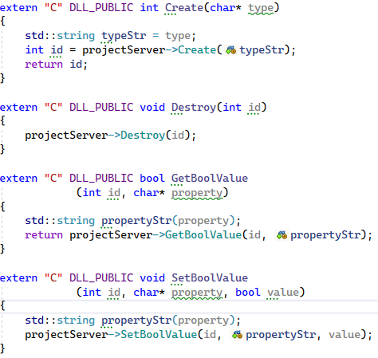
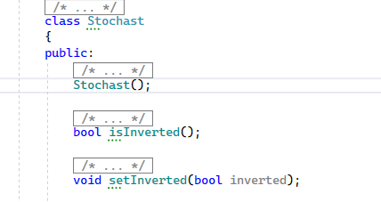
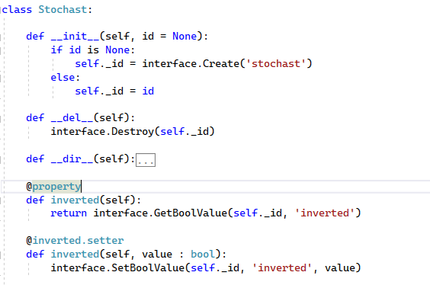
Probabilistic library – Language interface 1
Python
C DLL
C++
Shadow class
Base class

Slide 10
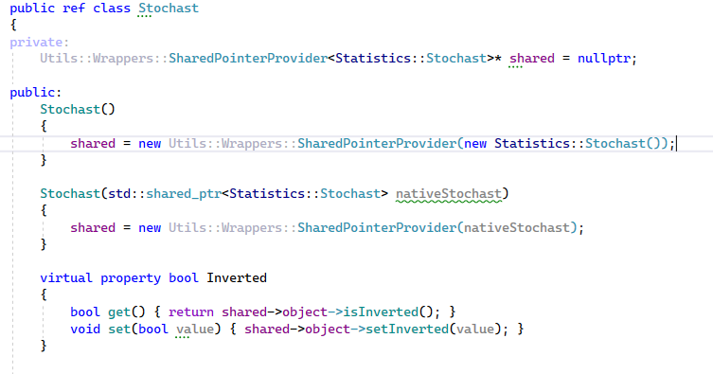
Probabilistic library – Language interface 2
C++ / CLI
C++
Shadow class
Base class

Slide 11
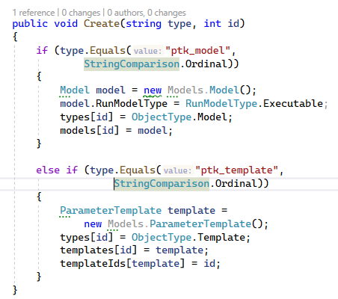
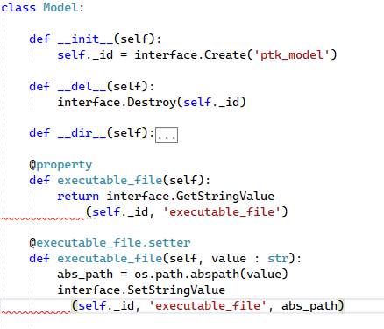
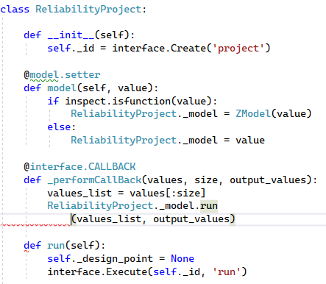
Probabilistic library – Language interface 3
C# / PTK
Python PTK
Python Streams
C++
Base class
Shadow class
Server proces
Use Model in model

Slide 12
Demo 1
Notebooks:
  Run up example
  Hydra-Ring
  Probabilistic toolkit connection

Slide 13
Demo 2
JIRA
Github
TeamCity
  Sig build
  Code coverage build
  Treintje voor python build/tests

Slide 14
Using the Probabilistic Library
Wheels available
  ask us
Pizza course
  Start of November, to be announced

Slide 15
Contact
www.deltares.nl/en/software-and-data/products/probabilistic-toolkit-ptk
rob.brinkman@deltares.nl , edwin.spee@deltares.nl
facebook.com/deltaresNL
linkedin.com/company/deltares
@deltares
@deltaresNL

